Slide 1
Asynchronous
Programming
David Tarvin, AIM Code School

Slide 2
Asynchronous vs Synchronous
Synchronous programming - things happen one at at time
Problematic if the task being executed takes time, like a network request
Program can’t make progress
Asynchronous programming - allows multiple things to happen at the same time
When an action is started, the program continues to run
When the action finishes, the program is informed and gets access to the result

Slide 3
Asynchronous vs Synchronous (cont’d)
Example - program making two requests and combining the results
Synchronous - make the requests one after the other
Drawback - second request will be started only when the first one has finished
Total time taken will be at least the sum of the two response times
Solution for synchronous - start additional threads of control
A thread is another running program whose execution may be inserted along with other programs by the operating system
Threads could run at the same time on different processors
A second thread could start the second request, then both threads wait for results to come back, then they resynchronize to combine results

Slide 4
Asynchronous vs Synchronous (cont’d)
Why doesn’t JavaScript use multi-threading?
Javascript is a scripting language that was only intended for browsers, which were not very fast when JavaScript was created
JavaScript was kept single-threaded so that operations in the browsers would not get blocked due to multiple requests

Slide 5
Callbacks - An approach to asynchronous programming
A callback function is a function that is called by another function to do something when a process finishes
A function that has to wait for something and then do something after the waiting is over will take a function as an extra argument
The function that has to wait for something is sometimes called the asynchronous function, or is sometimes called the callout function
The function that is provided as an extra argument to the asynchronous (async) function is called the callback function
The async function starts a process and sets things up so that the callback function is called when the process finishes, and then returns

Slide 6
Callbacks (cont’d)
Examples of callbacks:
setTimeout() waits a certain number of milliseconds and then calls a function
setTimeout(() => console.log(‘Tick’), 500);
Reading a file from a device’s storage
Function that reads a text file’s content as a string and passes it to a callback function to console.log the results readTextFile(“shopping_list.txt”, content => { console.log(`Shopping List:\n$(content)`); });
// Shopping List:
// Peanut butter
// Bananas

Slide 7
Callbacks (cont’d)
Drawbacks to simply using callbacks:
Performing multiple async operations in a row using callbacks means you have to keep passing new functions to handle the continuation of the computation after the actions
Example: A function that compares two files and produces a boolean indicating whether their content is the same
function compareFiles(fileA, fileB, callback) { readTextFile(fileA, contentA => { readTextFile(fileB, contentB => { callback(contentA == contentB); }); }); }

Slide 8
Callbacks (cont’d)
Any function that calls a function that works asynchronously must itself be asynchronous, using a callback or similar mechanism to deliver its result
Having multiple nested callback functions is known as callback hell
Multiple nested callback functions makes the code complex, hard to read, and challenging to read, debug, and generally maintain

Slide 9
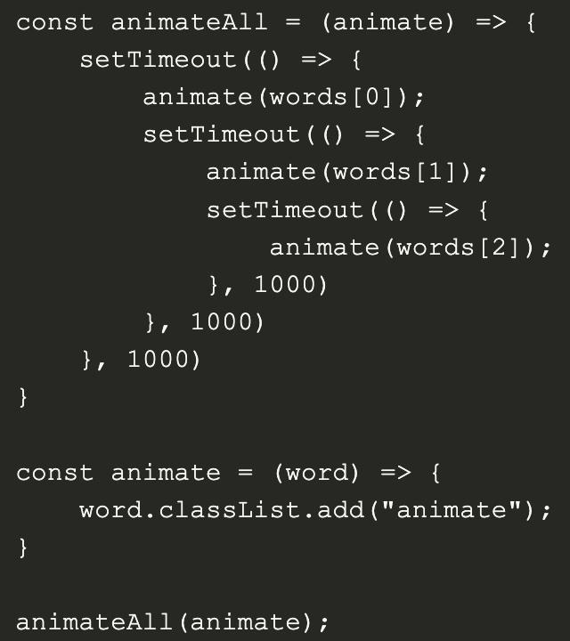
Callbacks (cont’d)

Slide 10
Promises
Like callbacks, promises allow us to wait on certain code to finish execution before running the next bit of code
A Promise represents the eventual result of an async operation
It is a guarantee that something will happen in the future
Just like people, the Promise will be kept or not kept
A JavaScript Promise is a placeholder object for something that is supposed to be returned from the server and on which we can attach callbacks

Slide 11
Promises (cont’d)
A Promise has three states:
Pending - the async operation hasn’t completed yet
Fulfilled - the operation has completed and the Promise has a value
Rejected - the operation has completed with an error or has failed
Once a Promise has settled, it is settled for good and cannot transition

Slide 12
Promises (cont’d)
Promise syntax:
runFunction().then(successFunc, failureFunc);
First, invoke runFunction()
runFunction() returns a Promise
Once the Promise is settled:
If the Promise is fulfilled, successFunc is invoked
If the Promise fails, failureFunc is invoked

Slide 13
Promises (cont’d)
A Promise takes as callback function as a parameter, usually an arrow function
The callback function takes two functions as parameters - resolve and reject
They have to be included as parameters in order for them to be used
Can be named anything - the first will always be resolved and the second will always be reject
Don’t include parentheses after them because doing so would cause the functions to execute immediately

Slide 14
Promises (cont’d)
The callback function passes as a parameter for the Promise can be called promise_executor
The resolve and reject functions are callbacks provided by the Promise instance
Each of those functions take one parameter that is of type Object
If the Promise is resolved, the resolve method passes the parameter to the .then callback function
If the Promise is rejected, the reject method passes the parameter to the .catch callback function

